Slide 1
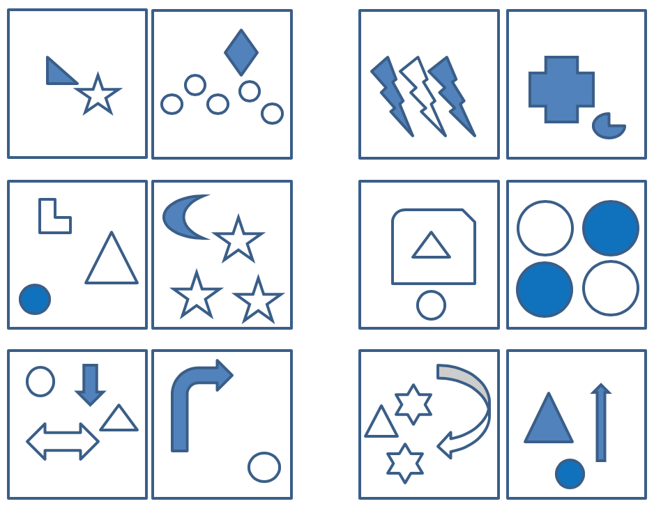
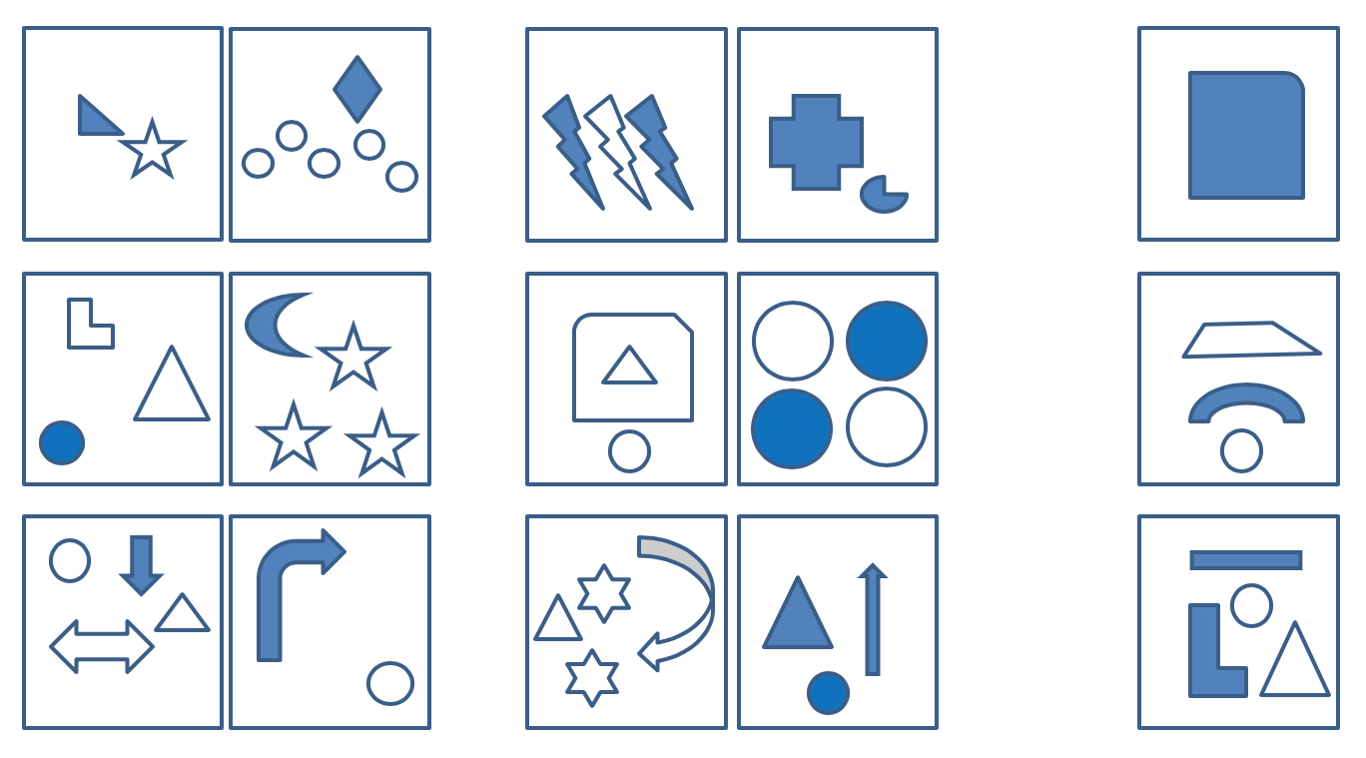
Pattern Detector
In the following you will be shown two sets of six images each.
The the images in each set have something in common that distinguishes them from the other set.
Your task is to identify the rule that separates one set from the other.
For each of the three images shown on the right hand side you then need to decide whether they belong to the RIGHT set or the LEFT set.
Let’s start with an example

Slide 2
This is an example.
One could say that all the images in set L contain one and only one solid blue shape.
The images in set R have either none or more than one solid shape.
Therefore, the first image on the left belongs to set L, the same is true for the second image on the left.
The third image on the left belongs to set R.
L
L or R?
L
L or R?
R
L or R?
L
R
Notes:
L1: Exactly one blue shape
L2: Exactly one triangle
L3: Circle the lowest shape

Slide 3
This is an example (part 2).
Press continue and you will see that the images are reshuffled.
This makes the old rule obsolete. Can you see what the new rule is?
One could say that all the images in set L contain one triangle. That is not the case for set R.
Therefore, the first two images on the left belong to set R. Only the third image belongs to set L.
R
L or R?
R
L or R?
L
L or R?
L
R
Notes:
L1: Exactly one blue shape
L2: Exactly one triangle
L3: Circle the lowest shape

Slide 4
This is an example (part 3).
Once you have pressed continue again the images are reshuffled for a second time.
What is the new rule now?
In set L on the bottom of each image there is a circle. That is not the case for set R.
Therefore, the first and the third image on the left belong to set R. Only the second image belongs to set L.
R
L or R?
L
L or R?
R
L or R?
L
R
Notes:
L1: Exactly one blue shape
L2: Exactly one triangle
L3: Circle the lowest shape

Slide 5
Before you start …
The puzzles presented in the following will use shapes, numbers, or letters.
The task will always be the same: Find the rule that separates the sets and sort the images on the right side of the screen to either of the sets according to the rule.
To do that, simply drag an drop each of the three images onto either the left or the right set.
Sometimes you need to think somewhat “outside the box”.
Press continue to start the Pattern Detector Task
Notes:
Response mode:
Drag and drop:
Drag: whilst the image remains in place (maybe with some transparency), a copy of it moves with the mouse
Once a target stimulus has been dropped onto either the left or the right set, an “L” or “R” emerges next to the image (see instruction)
Correction possible by simply moving (drag and drop) the image again (letter changes accordingly).
Continue to the next item only possible after all three targets have been sorted
After all three stimuli have been sorted a <submit> button becomes active which, once pressed, leads to the next screen with the next item (/ item triplet part).
Options:
Show sets only → ask for confidence → show targets
show sets only → ask for rule → show targets
Do both …

Slide 6
Notes re Response Modus
Drag and drop:
Drag: whilst the image remains in place (maybe with some transparency), “a copy of it” moves with the mouse
Once a target stimulus has been dropped onto either the left or the right set, an “L” or “R” emerges next to the image (as shown in instruction)
Correction possible by simply moving (drag and drop) the image again (letter changes accordingly).
Continue to the next item only possible after all three targets have been sorted
After all three stimuli have been sorted a <submit> button becomes active which, once pressed, leads to the next screen with the next item (/ item triplet part).

Slide 7
This is an example.
One could say that all the images in set L contain one and only one solid blue shape.
The images in set R have either none or more than one solid shape.
Therefore, the first image on the left belongs to L, the same is true for the second image on the left.
The third image on the left belongs to set R.
L or R?
L or R?
L or R?
L
R
Notes:
L1: Exactly one blue shape
L2: Exactly one triangle
L3: Circle the lowest shape

Slide 8
100
723
17
8
464
323
197
0
2
1
315
313
99
42
72
How confident are you that you have figured out what makes these two sets different
from one another?
Your answers were correct /incorrect. The rule was:
“The left set comprises three-digit numbers whilst the right set does not.”
Your answers were correct /incorrect. The rule was:
“The images in the left set have all an enclosed area whilst the images in the right set do not.”
Your answers were correct /incorrect. The rule was:
“The left set comprises palindromic numbers whilst the right set does not.”
Please sort now these three images to either the right or left set (drag and drop).
Present slider here
1/6
Notes:
L1: three-digit numbers (LRR)
L2: Palindromic numbers (LRR)
L3: Contains an enclosed area (LRR)

Slide 9
100
723
17
8
464
323
197
0
2
1
315
313
99
42
72
Notes:
L1: 3 digit numbers (LRR)
L2: Palindromic numbers (LRR)
L3: Contains an enclosed area (LRR)

Slide 10
APT
CL
XY
HFH
ET
UU
WS
Z
IF
RXA
BAC
R
MNV
NE
QQ
Notes:
L1: At least one of the letters has a curve
L2: Odd number of letters
L3:At least one non-black letter

Slide 11
APT
NE
XY
HFH
ET
UU
WS
Z
CL
RXA
BAC
IF
MNV
R
QQ
Notes:
L1: At least one non-black letter
L2: At least one of the letters has a curve
L2: Odd number of letters

Slide 12
APT
NE
XY
HFH
ET
UU
WS
Z
CL
RXA
BAC
IF
MNV
R
QQ
2/6
Notes:
L1: At least one non-black letter (LLR)
L2: At least one of the letters has a curve (RLL)
L3: Odd /even number of letters (RLR)

Slide 13
Notes:
L1: Equal number of dots either side of line
L2: Horizontal or vertical line (i.e right hand side is diagonal)
L3: 2 blue dots

Slide 14
3/6
Notes:
L1: Equal number of dots either side of line (RRL)
L2: Orthogonal line (LRR)
L3: 2 blue dots (RLL)

Slide 15
Notes:
L1: Arrow pointing at all of the circles
L2: Exactly 4 elements in each box
L3: Contains both blue and red shapes

Slide 16
4/6
Notes:
L1: 4 elements per panel (RRL)
L1: Arrow pointing at a circle (LRR)
L3: Contains both blue and red shapes (LRL)

Slide 17
A
=
7
42
D
Notes:
L1: Black
L2: Consists entirely of straight lines
L3: Can be drawn in a consecutive line (without back tracing)

Slide 18
=
A
7
D
42
5/6
Notes:
L1: Black (LRL)
L2: Consists of straight lines only (LRR)
L3: Can be drawn in one consecutive line without back tracing (RLL)

Slide 19
8
Q
6
c
e
Y
R
6/6
Notes:
L1: Alphanumeric characters (RLR)
L2: Exactly one bounded interior area (RLL)
L3: Exactly two “loose” ends (RRL)

Slide 20
RO
TU
AN
PJ
GO
SE
MI
BV
CZ
OK
DA
QO
FH
LW
YX
Notes:
A1: pair ends in a vowel
A2: at least one element encloses an area

Slide 21
48
26
49
81
34
32
14
97
53
63
84
60
79
15
11
Notes:
A1: even numbers
A2: first element encloses an area

Slide 22
Notes:
A1: two intersections vs. one intersection
A2: one line vs. two lines

Slide 23
Notes:
A1: two intersections vs. one intersection
A2: one line vs. two lines
A3: squiggly vs. straight lines

Slide 24
Notes:
A1: two intersections vs. one intersection
A2: straight vs. squiggly

Slide 25
?!
ml
(☆
↑M
@.
g↓
61
˚§
i→
⦒&
H*
W/
1‱
lQ
1€
Notes:
A1: left element wider than right element
B2: at least one element in each pair encloses an area

Slide 26
?!
ml
(☆
↑M
@.
g↓
61
˚§
i→
⦒&
H*
W/
1‱
lQ
1€
Notes:
A1: left element wider than right element
A2: both elements from the same category

Slide 27
MA
TU
XI
DE
AT
IX
WI
IB
CH
XW
YV
∏∩
BO
+∃
∑∏
Notes:
A1: vertically symmetrical
A2: pair ends with a vowel

Slide 28
A
E
Q
X
Z
F
H
K
S
I
L
T
O
J
M
Notes:
A1: horizontal line
A2 horizontally or vertically symmetrical

Slide 29
{
£
~
☛
↷
|
∏
↩︎
…
!
‡
T
⥰
‱
m
Notes:
set A: higher than wide

Slide 30
H
I
A
D
Z
N
O
E
J
U
S
X
M
Q
W
Notes:
A1: rotationally symmetrical

Slide 31
Notes:
a rather simple item
A1: triangle above circle
A2: circle right of triangle
A3: upward vs. downward facing triangle
(A4: numbers / ratio … after adding more elements)
(A5: absolute position: in the upper half vs. in the lower half; left / right; same quadrant vs. not in the same quadrant etc.)

Slide 32
Notes:
a rather simple item (maybe to be used as instruction item)
A1: triangle above circle
A2: circle right of triangle
A3: upward vs. downward facing triangle
(A4: numbers / ratio … after adding more elements)
(A5: absolute position: in the upper half vs. in the lower half; left / right; same quadrant vs. not in the same quadrant etc.)

